Slide 1

计算机组成与系统结构 Computer Organization & System Architecture
Huang Kejie (黄科杰) 百人计划研究员
Office: 玉泉校区老生仪楼304
Email address: huangkejie@zju.edu.cn
HP: 17706443800

Slide 2
Agenda
Parallel processing
Single instruction, multiple data
SIMD matrix multiplication
Amdahl’s law
Loop unrolling
Memory access strategy - blocking
And in Conclusion, …

Slide 3
Reference Problem
Matrix multiplication
Basic operation in many engineering, data, and imaging processing tasks
Image filtering, noise reduction, …
Many closely related operations
dgemm
double-precision floating-point matrix multiplication

Slide 4
Application Example: Deep Learning
Image classification (cats …)
Pick “best” vacation photos
Machine translation
Clean up accent
Fingerprint verification
Automatic game playing

Slide 5


Matrices
Square matrix of dimension NxN
$$j$$
0
N-1
0
$$i$$
N-1

Slide 6




Matrix Multiplication
$$j$$
B
C = A*B
C_{ij} = Σ_{k} (A_{ik} * B_{kj})
$$k$$
$$k$$
A
C
$$i$$

Slide 7
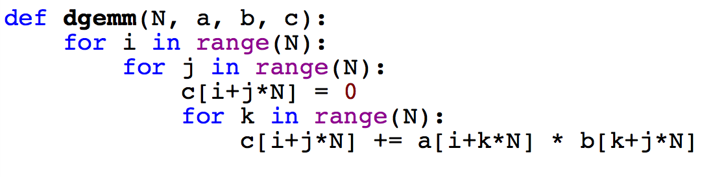
Reference: Python
Matrix multiplication in Python
N | Python [Mflops]
32 | 5.4
160 | 5.5
480 | 5.4
960 | 5.3
1 MFLOP = 1 Million floating-point operations per second (fadd, fmul)
dgemm(N …) takes 2*N³ flops

Slide 8
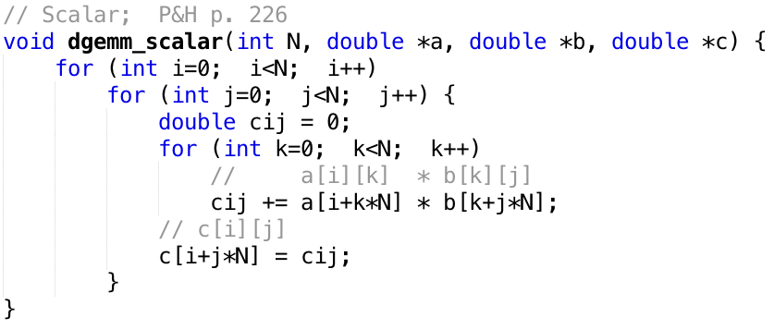
C
c = a * b
a, b, c are N x N matrices

Slide 9
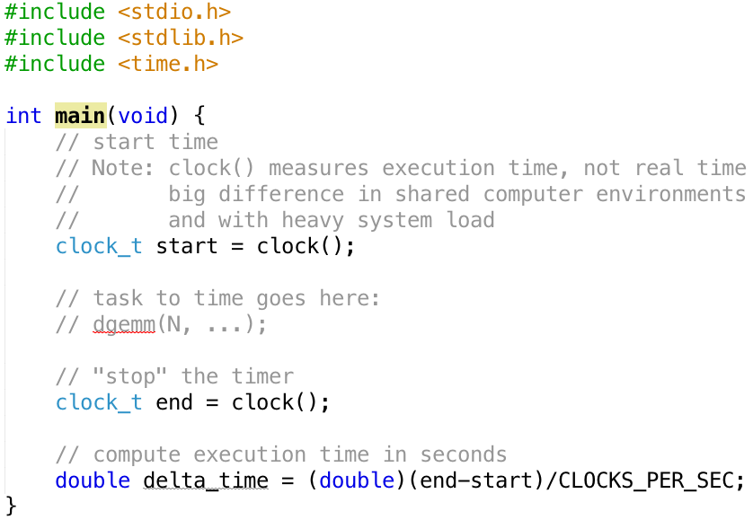
Timing Program Execution

Slide 10
C versus Python
N | C [GFLOPS] | Python [GFLOPS]
32 | 1.30 | 0.0054
160 | 1.30 | 0.0055
480 | 1.32 | 0.0054
960 | 0.91 | 0.0053
240x!
Which class gives you this kind of power?
We could stop here … but why? Let’s do better!

Slide 11
Why Parallel Processing?
CPU Clock Rates are no longer increasing
Technical & economic challenges
Advanced cooling technology too expensive or impractical for most applications
Energy costs are prohibitive
Parallel processing is only path to higher speed
Compare airlines:
Maximum speed limited by speed of sound and economics
Use more and larger airplanes to increase throughput
And smaller seats …

Slide 12
Using Parallelism for Performance
Two basic ways:
Multiprogramming
run multiple independent programs in parallel
“Easy”
Parallel computing
run one program faster
“Hard”
We’ll focus on parallel computing in the next few lectures

Slide 13


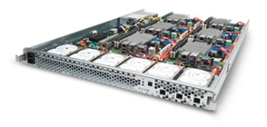
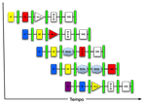
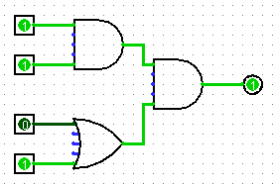
New-School Machine Structures (It’s a bit more complicated!)
Parallel Requests
Assigned to computer
e.g., Search “Katz”
Parallel Threads
Assigned to core
e.g., Lookup, Ads
Parallel Instructions
>1 instruction @ one time
e.g., 5 pipelined instructions
Parallel Data
>1 data item @ one time
e.g., Add of 4 pairs of words
Hardware descriptions
All gates @ one time
Programming Languages
Software Hardware
Warehouse Scale Computer
Smart Phone
Harness Parallelism &
Achieve High Performance
Computer
Core
…
Core
Memory (Cache)
Input/Output
Core
Instruction Unit(s)
Functional
Unit(s)
Today’s
Lecture
A₀+B₀
A₁+B₁
A₂+B₂
A₃+B₃
Cache Memory
Logic Gates

Slide 14
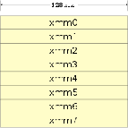
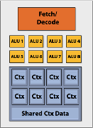
Types of Parallelism
Parallelism in Hardware (Uniprocessor)
Parallelism in a Uniprocessor
Pipelining
Superscalar, VLIW etc.
SIMD instructions, Vector processors, GPUs
Multiprocessor
Symmetric shared-memory multiprocessors
Distributed-memory multiprocessors
Chip-multiprocessors a.k.a. Multi-cores
Multicomputers a.k.a. clusters
Parallelism in Software
Instruction level parallelism
Task-level parallelism
Data parallelism
Transaction level parallelism

Slide 15
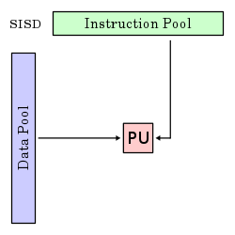
Single-Instruction/Single-Data Stream (SISD)
Sequential computer that exploits no parallelism in either the instruction or data streams. Examples of SISD architecture are traditional uniprocessor machines
E.g. our trusted RISC-V pipeline
Processing Unit
This is what we did up to now in this course

Slide 16
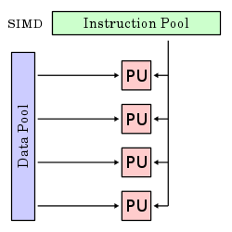
Single-Instruction/Multiple-Data Stream (SIMD or “sim-dee”)
SIMD computer exploits multiple data streams against a single instruction stream to operations that may be naturally parallelized
e.g., Intel SIMD instruction extensions or NVIDIA Graphics Processing Unit (GPU)
Today’s topic.

Slide 17
Multiple-Instruction/Multiple-Data Streams (MIMD or “mim-dee”)
Multiple autonomous processors simultaneously executing different instructions on different data.
MIMD architectures include multicore and Warehouse-Scale Computers
Instruction Pool
PU
PU
Data Pool
PU
PU
Succeeding topic and beyond.

Slide 18
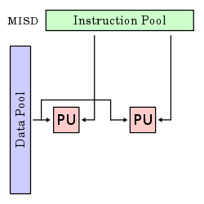
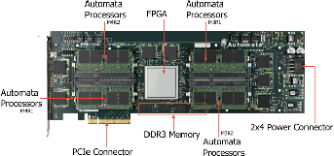
Multiple-Instruction/Single-Data Stream (MISD)
Different instructions on the same data
Fault-tolerant computers, Near memory computing (Micron Automata processor).
This has few applications. Not covered in this course

Slide 19
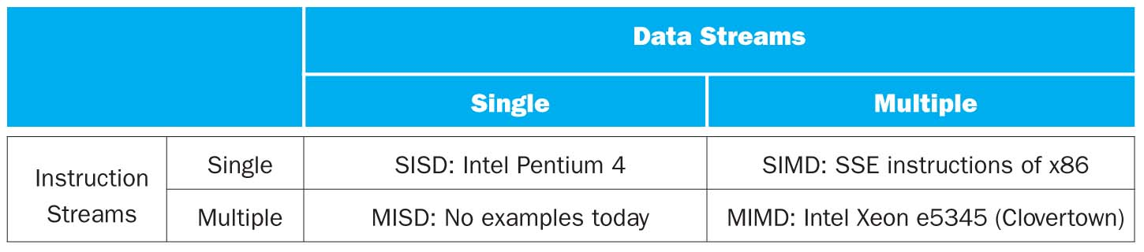
Flynn* Taxonomy, 1966
SIMD and MIMD are currently the most common parallelism in architectures – usually both in same system!
Most common parallel processing programming style: Single Program Multiple Data (“SPMD”)
Single program that runs on all processors of a MIMD
Cross-processor execution coordination using synchronization primitives

Slide 20
SIMD Applications & Implementations
Applications
Scientific computing
Matlab, NumPy
Graphics and video processing
Photoshop, …
Big Data
Deep learning
Gaming
…
Implementations
x86
ARM
RISC-V vector extensions

Slide 21
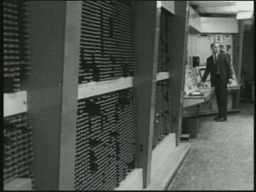
First SIMD Extensions: MIT Lincoln Labs TX-2, 1957

Slide 22
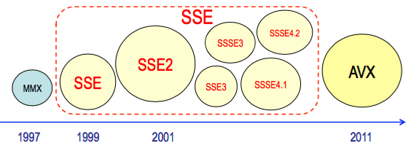
x86 SIMD Evolution
New instructions
New, wider, more registers
More parallelism
http://svmoore.pbworks.com/w/file/fetch/70583970/VectorOps.pdf

Slide 23
Laptop CPU Specs
$ sysctl -a | grep cpu
hw.physicalcpu: 2
hw.logicalcpu: 4
machdep.cpu.brand_string: Intel(R) Core(TM) i7-5557U CPU @ 3.10GHz
machdep.cpu.features: FPU VME DE PSE TSC MSR PAE MCE CX8 APIC SEP MTRR PGE MCA CMOV PAT PSE36 CLFSH DS ACPI MMX FXSR SSE SSE2 SS HTT TM PBE SSE3 PCLMULQDQ DTES64 MON DSCPL VMX EST TM2 SSSE3 FMA CX16 TPR PDCM SSE4.1 SSE4.2 x2APIC MOVBE POPCNT AES PCID XSAVE OSXSAVE SEGLIM64 TSCTMR AVX1.0 RDRAND F16C
machdep.cpu.leaf7_features: SMEP ERMS RDWRFSGS TSC_THREAD_OFFSET BMI1 AVX2 BMI2 INVPCID SMAP RDSEED ADX IPT FPU_CSDS

Slide 24
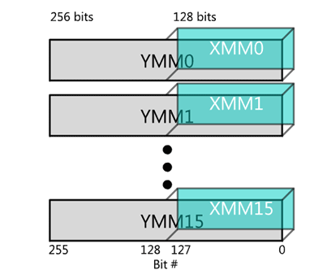
SIMD Registers

Slide 25
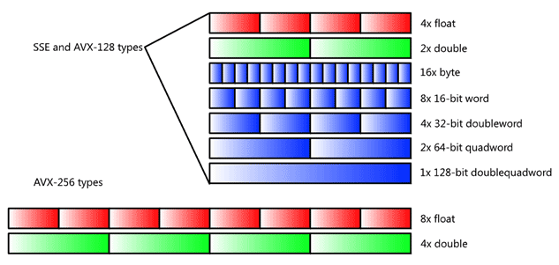
SIMD Data Types
(Now also AVX-512 available)

Slide 26
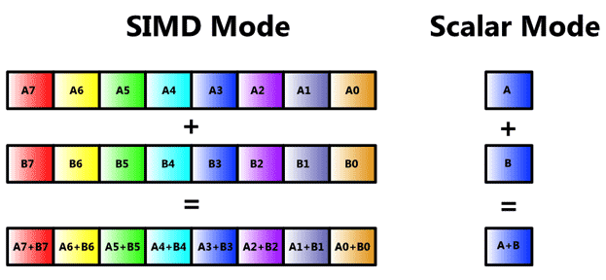
SIMD Vector Mode

Slide 27
Problem
Today’s compilers (largely) do not generate SIMD code
Back to assembly …
x86 (not using RISC-V as no vector hardware yet)
Over 1000 instructions to learn …
Green Book
Can we use the compiler to generate all non-SIMD instructions?

Slide 28
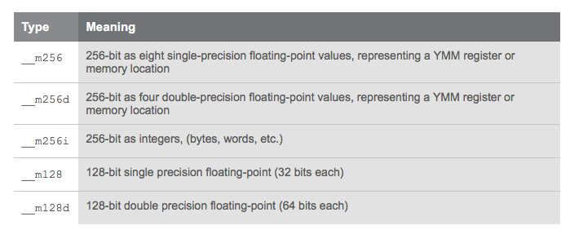
x86 Intrinsics AVX Data Types
Intrinsics: Direct access to registers & assembly from C
Register

Slide 29
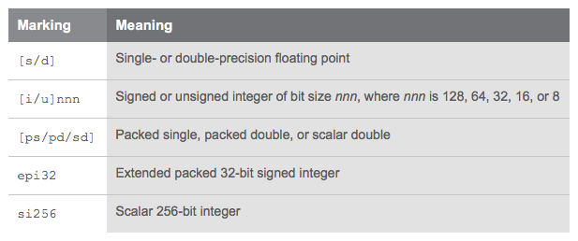
Intrinsics AVX Code Nomenclature

Slide 30
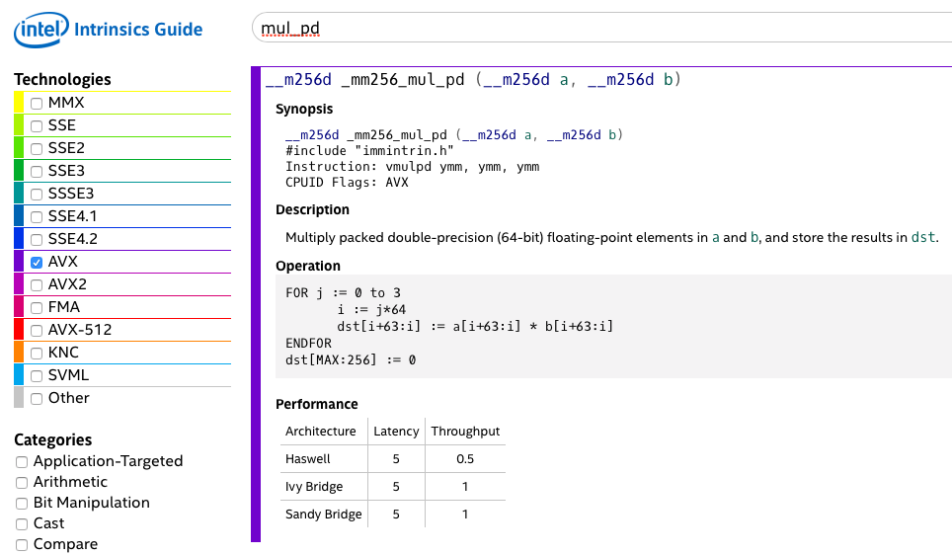
x86 SIMD “Intrinsics”
assembly instruction
4 parallel multiplies
2 instructions per clock cycle (CPI = 0.5)
https://software.intel.com/sites/landingpage/IntrinsicsGuide/

Slide 31
Raw Double-Precision Throughput
Characteristic | Value
CPU | i7-5557U
Clock rate (sustained) | 3.1 GHz
Instructions per clock (mul_pd) | 2
Parallel multiplies per instruction | 4
Peak double FLOPS | 24.8 GFLOPS
https://www.karlrupp.net/2013/06/cpu-gpu-and-mic-hardware-characteristics-over-time/
Actual performance is lower because of overhead

Slide 32
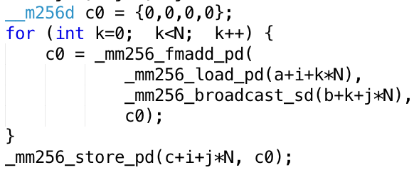




Vectorized Matrix Multiplication
for i …; i+=4
for j ...
$$j$$
Inner Loop:
$$k$$
$$k$$
i += 4
$$i$$

Slide 33
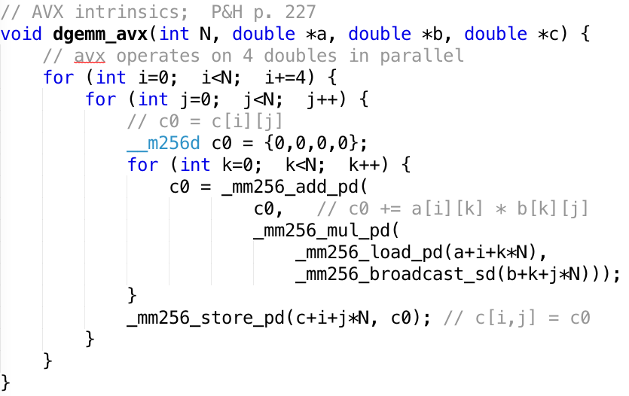
“Vectorized” dgemm

Slide 34
Performance
N | Gflops
 | scalar | avx
32 | 1.30 | 4.56
160 | 1.30 | 5.47
480 | 1.32 | 5.27
960 | 0.91 | 3.64
4x faster
But still << theoretical 25 GFLOPS!

Slide 35
A trip to LA
Commercial airline:
Get to SFO & check-in | SFO → LAX | Get to destination
3 hours | 1 hour | 3 hours
Total time: 7 hours
Supersonic aircraft:
Get to SFO & check-in | SFO → LAX | Get to destination
3 hours | 6 min | 3 hours
Total time: 6.1 hours
Speedup:
Flying time S_{flight} = 60 / 6 = 10x
Trip time S_{trip} = 7 / 6.1 = 1.15x

Slide 36
Amdahl’s Law
Get enhancement E for your new PC
E.g. floating-point rocket booster
E
Speeds up some task (e.g. arithmetic) by factor SE
F is fraction of program that uses this ”task”
Execution Time:
no speedup
speedup section
T₀ (no E)
1-F | F
T_{E} (with E)
1-F | F / S_{E}
Speedup:
Speedup = T_{O} / T_{E} = 1 / ((1-F) + F/S_{E})

Slide 37
Big Idea: Amdahl’s Law
Speedup = T_{O} / T_{E} = 1 / ((1-F) + F/S_{E})
Part not sped up
Part sped up
Example: The execution time of half of a program can be accelerated by a factor of 2. What is the program speed-up overall?
T_{O} / T_{E} = 1 / ((1-F) + F/S_{E}) = 1/((1- 0.5)+0.5/2) = 1.33 << 2

Slide 38
Maximum “Achievable” Speed-Up
Speedup = 1 / ((1-F) + F/S_{E})
(S_{E}->∞) = 1/(1-F)
Question: What is a reasonable # of parallel processors to speed up an algorithm with F = 95%? (i.e. 19/20th can be sped up)
a) Maximum speedup: S_{max} = 1/(1-0.95) = 20
but needs S_{E}=∞!
Reasonable “engineering” compromise:
Equal time in sequential and parallel code: (1-F) = F/S_{E}
S_{E} = F/(1-F) = 0.95/0.05 = 20
S = 1/(0.05+0.05) = 10

Slide 39
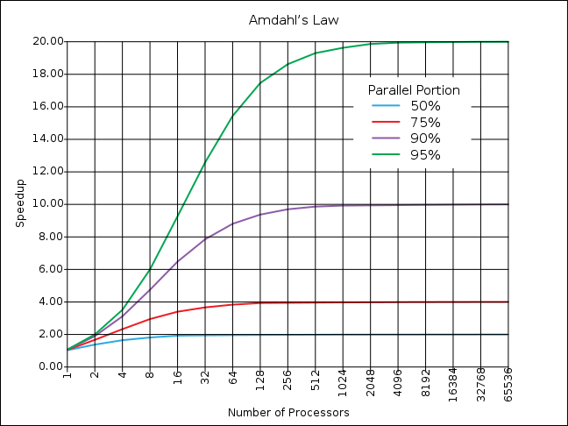
Maximum “Achievable” Speed-Up
If the portion of the program that can be parallelized is small, then the speedup is limited
500 processors
for 19x
In this region, the sequential portion limits the performance
20 processors
for 10x

Slide 40
Strong and Weak Scaling
To get good speedup on a parallel processor while keeping the problem size fixed is harder than getting good speedup by increasing the size of the problem.
Strong scaling: when speedup can be achieved on a parallel processor without increasing the size of the problem
Weak scaling: when speedup is achieved on a parallel processor by increasing the size of the problem proportionally to the increase in the number of processors
Load balancing is another important factor: every processor doing same amount of work
Just one unit with twice the load of others cuts speedup almost in half

Slide 41
Peer Instruction
Suppose a program spends 80% of its time in a square-root routine. How much must you speedup square root to make the program run 5 times faster?
Speedup = 1 / ((1-F) + F/S_{E})
RED: 5
GREEN: 20
ORANGE: 500
YELLOW: None of above

Slide 42
Amdahl’s Law applied to dgemm
Measured dgemm performance
Peak 5.5 GFLOPS
Large matrices 3.6 GFLOPS
Processor 24.8 GFLOPS
Why are we not getting (close to) 25 GFLOPS?
Something else (not floating-point ALU) is limiting performance!
But what? Possible culprits:
Cache
Hazards
Let’s look at both!

Slide 43
Pipeline Hazards – dgemm

Slide 44
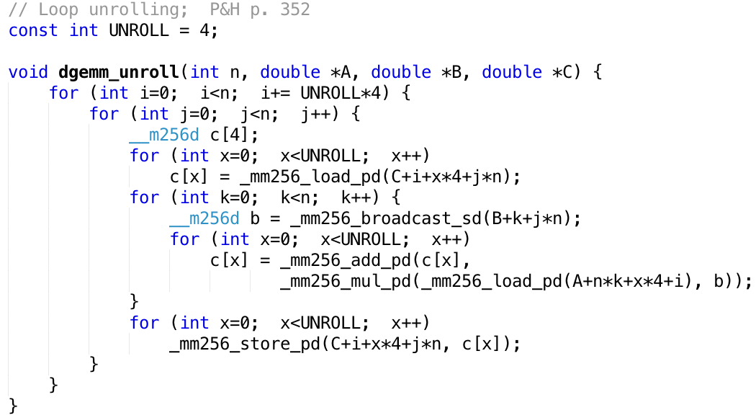
Loop Unrolling
4 registers
Compiler does the unrolling
How do you verify that the generated code is actually unrolled?

Slide 45
Performance
N | Gflops
 | scalar | avx | unroll
32 | 1.30 | 4.56 | 12.95
160 | 1.30 | 5.47 | 19.70
480 | 1.32 | 5.27 | 14.50
960 | 0.91 | 3.64 | 6.91
WOW!
?

Slide 46
FPU versus Memory Access
How many floating-point operations does matrix multiply take?
F = 2 x N³ (N³ multiplies, N³ adds)
How many memory load/stores?
M = 3 x N² (for A, B, C)
Many more floating-point operations than memory accesses
q = F/M = 2/3 * N
Good, since arithmetic is faster than memory access
Let’s check the code …

Slide 47
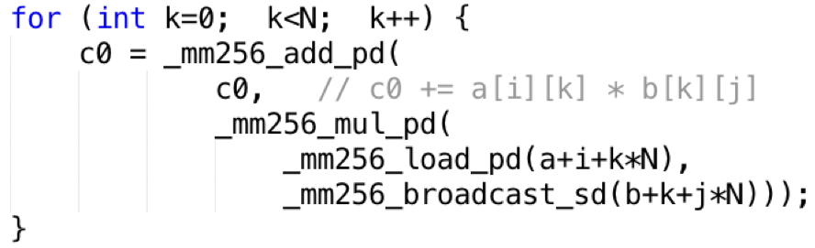
But memory is accessed repeatedly
Inner loop:
q = F/M = 1! (2 loads and 2 floating-point operations)

Slide 48
Typical Memory Hierarchy
On-Chip Components
Control
Third-Level
Cache
(SRAM)
Instr
Cache
Second-Level
Cache
(SRAM)
Main
Memory
(DRAM)
Secondary
Memory
(Disk
Or Flash)
Datapath
RegFile
Data
Cache
Speed (cycles): ½’s 1’s 10’s 100’s-1000 1,000,000’s
Size (bytes): 100’s 10K’s M’s G’s T’s
Cost/bit: highest lowest
Where are the operands (A, B, C) stored?
What happens as N increases?
Idea: arrange that most accesses are to fast cache!

Slide 49
Sub-Matrix Multiplication or: Beating Amdahl’s Law
Blocking:
Rearrange code to use values loaded in cache many times
Only “few” accesses to slow main memory (DRAM) per floating point operation
→ throughput limited by FP hardware and cache, not slow DRAM
P&H, RISC-V edition p. 465

Slide 50
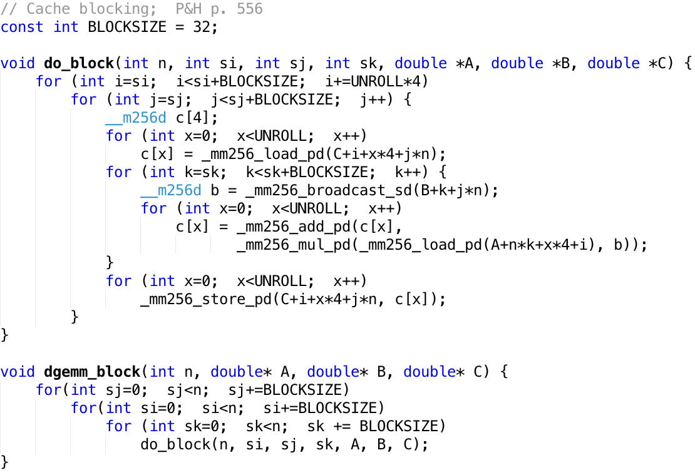
Memory Access Blocking

Slide 51
Performance
N | Gflops
 | scalar | avx | unroll | blocking
32 | 1.30 | 4.56 | 12.95 | 13.80
160 | 1.30 | 5.47 | 19.70 | 21.79
480 | 1.32 | 5.27 | 14.50 | 20.17
960 | 0.91 | 3.64 | 6.91 | 15.82

Slide 52
And in Conclusion, …
Approaches to Parallelism
SISD, SIMD, MIMD (next lecture)
SIMD
One instruction operates on multiple operands simultaneously
Example: matrix multiplication
Floating point heavy → exploit Moore’s law to make fast
Amdahl’s Law:
Serial sections limit speedup
Cache
Blocking
Hazards
Loop unrolling

